Slide 1
Model checking and sensitivity analysis

Slide 2
universal steps of data analysis
Model elicitation
Model fit
Model Checking
Specify:
Likelihood
+
Prior
Compare:
Posterior
To evidence from
(some) data
Obtain:
Posterior distribution
Implementation under the Bayesian paradigm

Slide 3
Questions asked in Bayesian...
Model checking
Sensitivity analysis
Model comparison
How much our model departs from evidence in the data?
How much it affects predictions of quantities of interest?
Is there an alternative model that can produce better results?

Slide 4
Model checking
Aim: determine how much our model departs from existing knowledge in the data.
Concept:
  If the model fits the data well, we could use it to generate new data that looks like the experimental data we have.
Computational Tool:
  Posterior predictive distribution

Slide 5
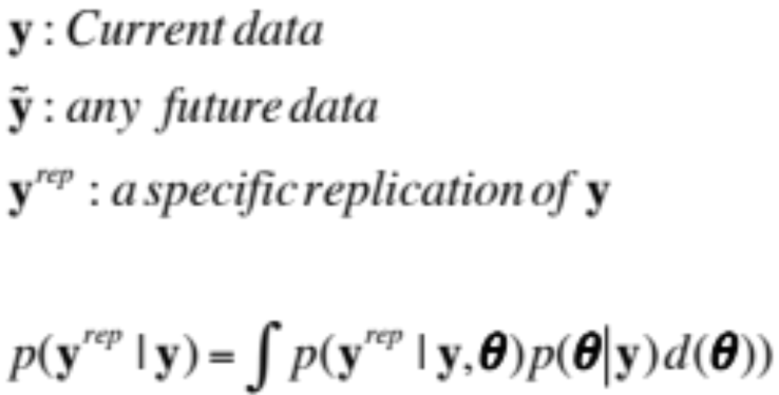
Posterior predictive distribution

Slide 6
Characteristics
Does not depend on the parameters
  They are integrated out
Can be obtained numerically using MCMC
  Sample a new dataset (conditional on current parameter values) on each iteration of the gibbs sampler
Can be summarized to provide goodness of fit measures
  (next)

Slide 7
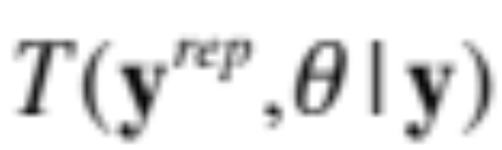
How to proceed?
MCMC
Replicated data
y^{rep}|θ₁,θ₂,
θ₁|θ₂,y
Optional
θ₂|θ₁,y
Test quantity to assess model fit

Slide 8
Test quantities
Scalar summary of parameters and data that is used as a standard when comparing predictive simulations to data
Mathematically, can depend on parameters but they will be marginalized over simulation
Example: skewness and kurtosis in a normal likelihood.

Slide 9
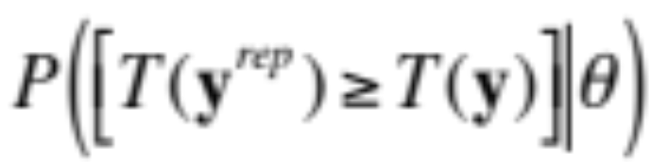
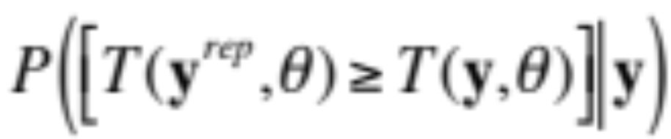
Tail area probabilities
We will use tail area probabilities of test quantities to assess lack of fit of data with respect to predictive posterior distribution
Classical p-value`
Bayesian p-value
or
Posterior predictive p-value

Slide 10
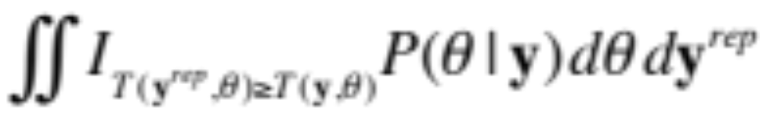
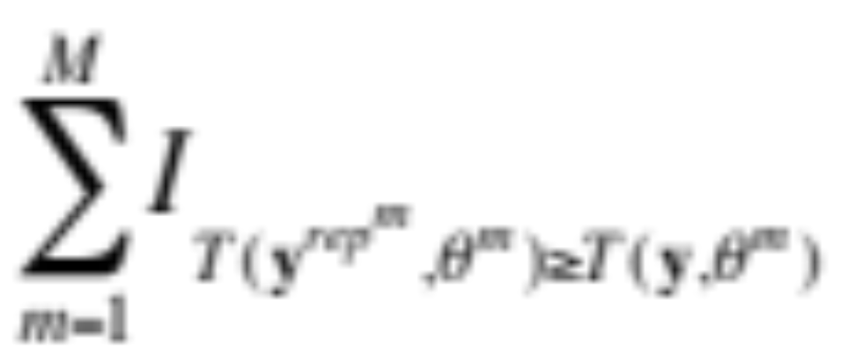
Bayesianly justifiable p-value
With MCMC:

Slide 11
Choosing test quantities
Select a statistic that reflects an aspect of data that is relevant to the purpose of the model
Think of any measure you would check in a classical data analysis setting
Examples:
  Residual correlations, ranks of samples, etc
Last resource: omnibus test quantities

Slide 12
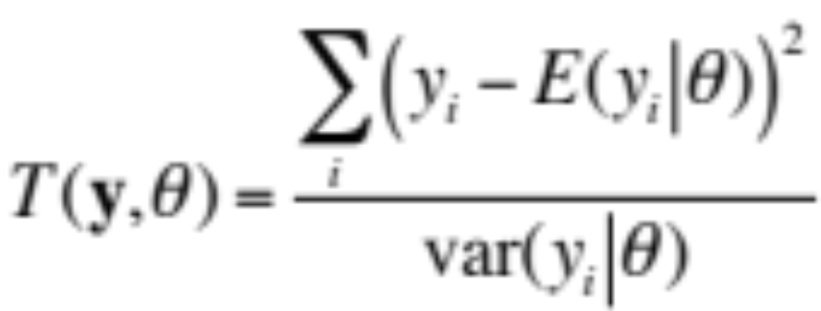
Chi-square discrepancy
A generic lack-of-fit measure that can be computed for any model.
The expectation and variance have to be worked out analytically and then computed on every iteration.
Pro: easy to elicit for any model
Con: if model checking reject model, we don’t know why
Better alternative: elicit measures that look at specific departures from model fit
bias, kurtosis, non-linearity, etc.

Slide 13
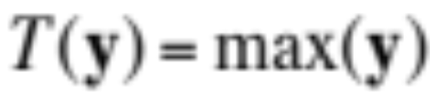
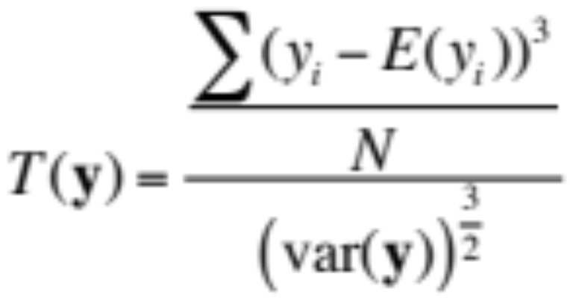
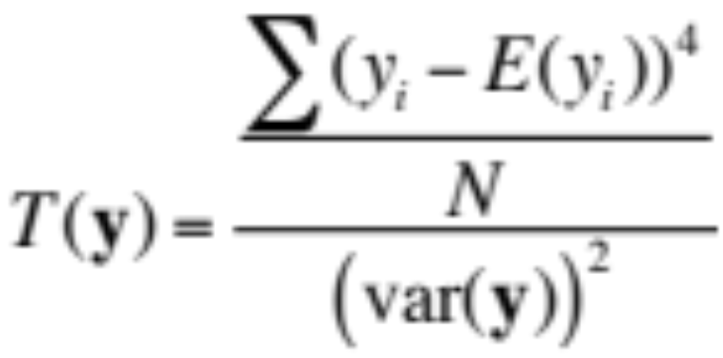
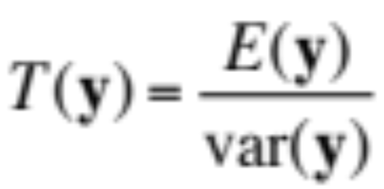
Some discrepancy measures
Is the largest value an outlier?
Skewness?
Kurtosis?
Overdispersion (e.g. poisson)

Slide 14
Interpretation
If p-value is close to 0 or 1, indicates the model is suspect.
Different from classical p-values, these are posterior probabilities!!!
DO NOT interpret them as numerical evidence against a null hypothesis.
If the p-value is extreme does not mean the model is not useful

Slide 15
What if we don’t compute tests?
Instead of computing test quantities…
graphically summarize distribution of replicated data and overlay observations (data)
Pay attention to where the data stands compared to the extremes of the replicated data

Slide 16
Replicated data and observations
Instead of computing test quantities…
graphically summarize distribution of replicated data and overlay observations (data)
Pay attention to where the data stands compared to the extremes of the replicated data

Slide 17
Implementation in R stan
Generate new observations conditional on model parameters (ALL model parameters)
Look at the posterior distribution of new observations and compare the observed data to them graphically or using summary statistics

Slide 18
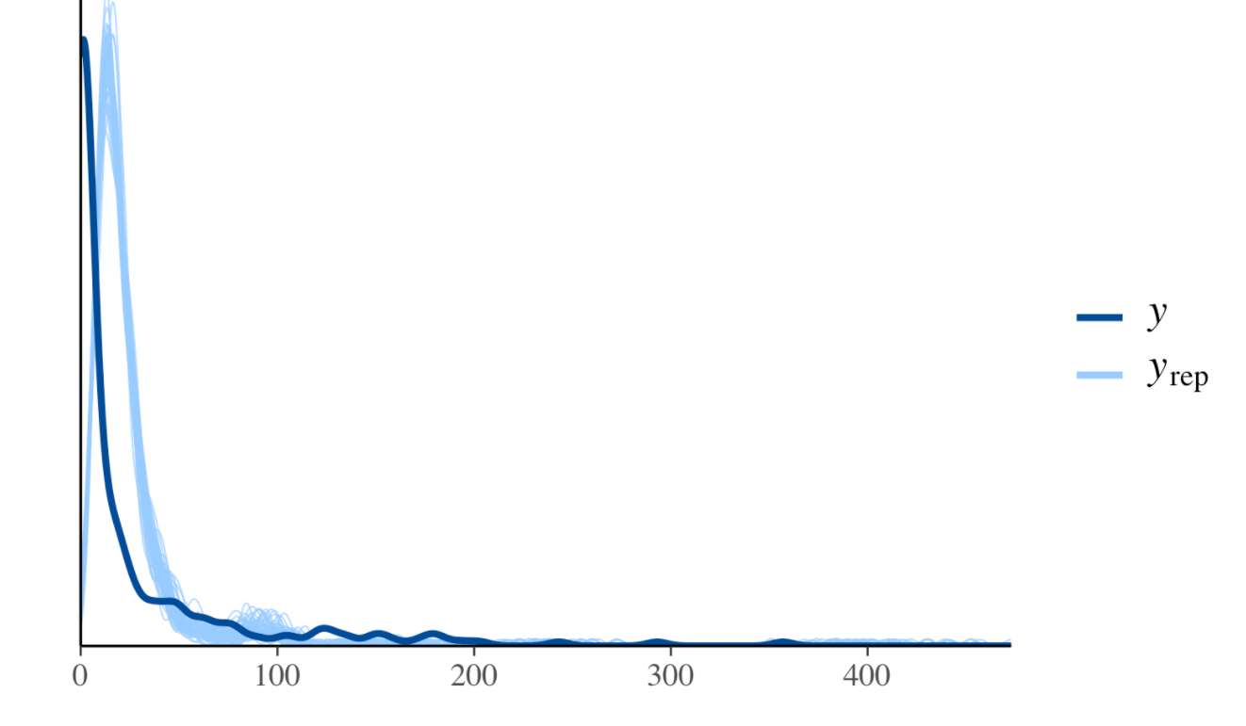
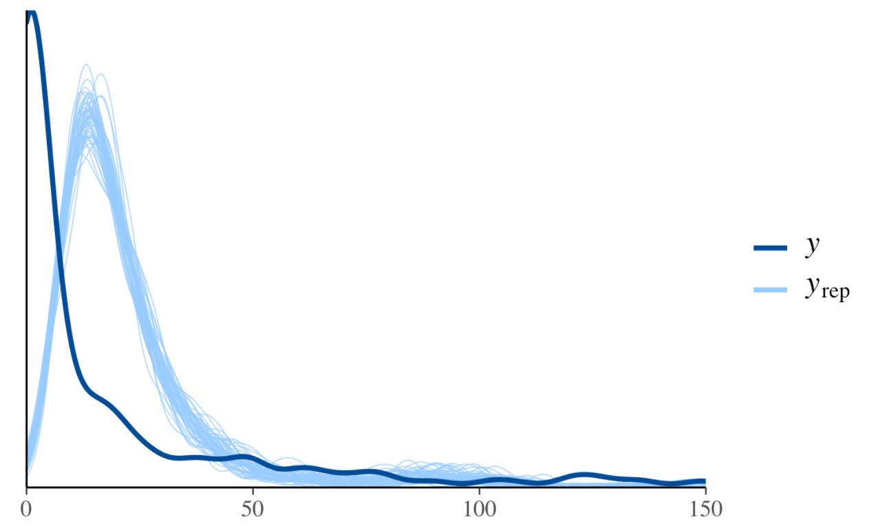
Compare distribution of y and yrep
Fit?
Definitely
Bad fit

